Slide 1

Application Layer Part 1
Mark Allman
Case / ICSI
EECS 325/425
Fall 2018
“All this energy callin’ me, back where it comes from; It’s such a crude attitude, back where it belongs”

Slide 2
Many of these slides are more-or-less directly from the slide set developed by Jim Kurose and Keith Ross for their book “Computer Networking: A Top Down Approach, 5th edition”.
The slides have been lightly adapted for Mark Allman’s EECS 325/425 Computer Networks class at Case Western Reserve University.
All material copyright 1996-2010
J.F Kurose and K.W. Ross, All Rights Reserved
Allman
2

Slide 3

Reading Along ...
The application layer is covered in Chapter 2 of the book
Read for re-inforcement and depth of understanding
Allman
3

Slide 4
Chapter 2: Application Layer
Our goals:
conceptual and implementation aspects of network application protocols
transport-layer service models
client-server paradigm
peer-to-peer paradigm
learn about protocols by examining popular application-level protocols
HTTP
SMTP / POP3 / IMAP
programming network applications
socket API

Slide 5
Some network apps
e-mail
web
instant messaging
remote login
P2P file sharing
multi-user network games
streaming stored video (YouTube)
voice over IP
real-time video conferencing
cloud computing
 …
 …


Slide 6









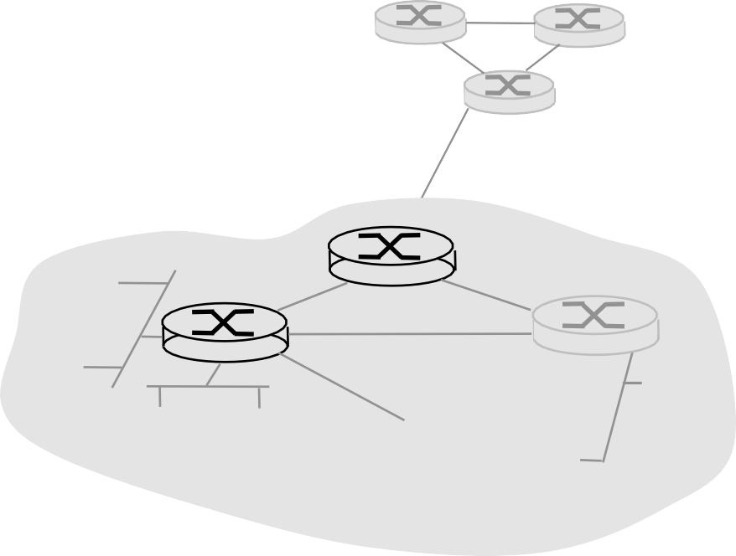







Creating a network app
write programs that
run on (different) end systems
communicate over network
e.g., web server software communicates with browser software
No need to write software for network-core devices
network-core devices do not
run user applications
 applications on end systems allows for rapid app development, propagation
Application 2-5

Slide 7




Creating a network app
write programs that
run on (different) end systems
communicate over network
e.g., web server software communicates with browser software
No need to write software for network-core devices
network-core devices do not
application
transport
network
data link
physical
application
transport
network
data link
physical
application
transport
network
data link
physical
run user applications
 applications on end systems allows for rapid app development, propagation
Application 2-5

Slide 8
Creating a network app
write programs that
run on (different) end systems
communicate over network
e.g., web server software communicates with browser software
No need to write software for network-core devices
network-core devices do not run user applications
applications on end systems allows for rapid app development, propagation
application
transport
network
data link
physical
application
transport
network
data link
physical
application
transport
network
data link
physical
Application 2-5

Slide 9
Reading Along ...
2.1: Principles of network applications
Allman
7

Slide 10
Application architectures
client-server
peer-to-peer (P2P)
hybrid of client-server and P2P

Slide 11















Client-server architecture
Application 2-8

Slide 12
Client-server architecture
server:
always-on host
permanent IP address
server farms for scaling
Application 2-8

Slide 13
Client-server architecture
server:
always-on host
permanent IP address
server farms for scaling clients:
communicate with server
may be intermittently connected
may have dynamic IP addresses
do not communicate directly with each other
Application 2-8

Slide 14
Client-server architecture
server:
always-on host
permanent IP address
server farms for scaling clients:
communicate with server
may be intermittently connected
may have dynamic IP addresses
do not communicate directly with each other
client/server
Application 2-8

Slide 15















Pure P2P architecture
Application 2-9

Slide 16


Pure P2P architecture
peer-peer
Application 2-9

Slide 17
Pure P2P architecture
 no always-on server
peer-peer
Application 2-9

Slide 18
Pure P2P architecture
no always-on server
arbitrary end systems directly communicate
peer-peer
Application 2-9

Slide 19
Pure P2P architecture
no always-on server
arbitrary end systems directly communicate
peer-peer
 peers are intermittently connected and change IP addresses
Application 2-9

Slide 20
Pure P2P architecture
no always-on server
arbitrary end systems directly communicate
peer-peer
 peers are intermittently connected and change IP addresses
highly scalable but difficult to manage
Application 2-9

Slide 21
Hybrid of client-server and P2P
Application 2-10

Slide 22
Hybrid of client-server and P2P
Skype
voice-over-IP P2P application
centralized server: finding address of remote party:
client-client connection: direct (not through server)
Application 2-10

Slide 23
Hybrid of client-server and P2P
Skype
voice-over-IP P2P application
centralized server: finding address of remote party:
client-client connection: direct (not through server)
Instant messaging
chatting between two users is P2P
centralized service: client presence detection/ location
user registers its IP address with central server when it comes online
user contacts central server to find IP addresses of buddies
Application 2-10

Slide 24
Processes communicating
Application 2-11

Slide 25
Processes communicating
process: program running within a host.
within same host, two processes communicate using inter-process communication (defined by OS).
processes in different hosts communicate by exchanging messages
Application 2-11

Slide 26
Processes communicating
process: program running within a host.
within same host, two processes communicate using inter-process communication (defined by OS).
processes in different hosts communicate by exchanging messages
client process: process that initiates communication
server process: process that waits to be contacted
Application 2-11

Slide 27
Processes communicating
process: program running within a host.
within same host, two processes communicate using inter-process communication (defined by OS).
processes in different hosts communicate by exchanging messages
client process: process that initiates communication
server process: process that waits to be contacted
 aside: applications with P2P architectures have client processes & server processes
Application 2-11

Slide 28
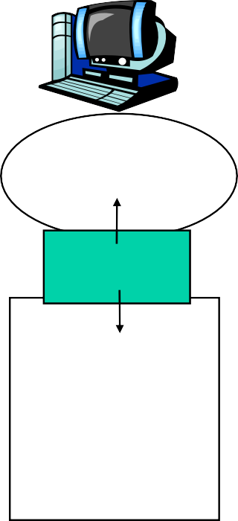

Sockets
process sends/receives messages to/from its socket
socket analogous to door
sending process shoves message out door
sending process relies on transport infrastructure on other side of door which brings message to socket at receiving process
host or server
host or server
controlled by app developer
process
process
socket
socket
TCP with buffers, variables
TCP with buffers, variables
Internet
controlled by OS
 API: (1) choice of transport protocol; (2) ability to fix a few parameters (lots more on this later)

Slide 29
Addressing processes
to receive messages, process must have identifier
host device has unique 32- bit IP address
Q: does IP address of host on which process runs suffice for identifying the process?

Slide 30
Addressing processes
to receive messages, process must have identifier
host device has unique 32-bit IP address
Q: does IP address of host on which process runs suffice for identifying the process?
 A: No, many processes can be running on same host

Slide 31
Addressing processes
to receive messages, process must have identifier
host device has unique 32-bit IP address
Q: does IP address of host on which process runs suffice for identifying the process?
 A: No, many processes
identifier includes both IP address and port numbers associated with process on host.
example port numbers:
HTTP server: 80
Mail server: 25
to send HTTP message to www.icir.org web server:
 IP address: 192.150.187.12
can be running on same host
 Port number: 80
Application 2-14

Slide 32
App-layer protocol defines
types of messages exchanged,
e.g., request, response
message syntax:
what fields in messages & how fields are delineated
message semantics
meaning of information in fields
rules for when and how processes send &
respond to messages
Application 2-15

Slide 33
App-layer protocol defines
types of messages exchanged,
e.g., request, response
message syntax:
what fields in messages & how fields are delineated
message semantics
meaning of information in fields
rules for when and how processes send & respond to messages
public-domain protocols:
defined in RFCs
allows for interoperability
e.g., HTTP, SMTP
proprietary protocols:
e.g., Skype

Slide 34
What transport service does an app need?
Application 2-16

Slide 35
What transport service does an app need?
Data loss
some apps (e.g., audio) can tolerate some loss
other apps (e.g., file transfer, login) require 100% reliable data transfer
Application 2-16

Slide 36
What transport service does an app need?
Data loss
some apps (e.g., audio) can tolerate some loss
other apps (e.g., file transfer, login) require 100% reliable data transfer
Timing
some apps (e.g., Internet telephony, interactive games) require low delay to be “effective”
Application 2-16

Slide 37
What transport service does an app need?
Data loss
some apps (e.g., audio) can tolerate some loss
other apps (e.g., file transfer, login) require 100% reliable data transfer
Timing
some apps (e.g., Internet telephony, interactive games) require low delay to be “effective”
Throughput
some apps (e.g., multimedia) require minimum amount of throughput to be “effective”
other apps (“elastic apps”) make use of whatever throughput they get
Application 2-16

Slide 38
What transport service does an app need?
Data loss
some apps (e.g., audio) can tolerate some loss
other apps (e.g., file transfer, login) require 100% reliable data transfer
Timing
some apps (e.g., Internet telephony, interactive games) require low delay to be “effective”
Throughput
some apps (e.g., multimedia) require minimum amount of throughput to be “effective”
other apps (“elastic apps”) make use of whatever throughput they get
Security
encryption, data integrity,
…
Application 2-16

Slide 39
Transport service requirements of common apps
Application
Data loss
Throughput
Time Sensitive
file transfer
e-mail
no loss no loss
elastic elastic
no no
Web documents
no loss
loss-tolerant
elastic
audio: 5kbps-1Mbps
no
yes, 100’s msec
real-time audio/video
video:10kbps-5Mbps
stored audio/video interactive games
loss-tolerant loss-tolerant
same as above few kbps up
yes, few secs yes, 100’s msec
instant messaging
no loss
elastic
yes and no

Slide 40
Internet transport protocols services
Application 2-18

Slide 41
Internet transport protocols services
TCP service:
connection-oriented: setup required between client and server processes
reliable transport between sending and receiving process
flow control: sender won’t overwhelm receiver
congestion control: throttle sender when network overloaded
does not provide: timing, minimum throughput guarantees, security
Application 2-18

Slide 42
Internet transport protocols services
TCP service:
connection-oriented: setup required between client and server processes
reliable transport between sending and receiving process
flow control: sender won’t overwhelm receiver
congestion control: throttle sender when network overloaded
does not provide: timing,
UDP service:
unreliable data transfer between sending and receiving process
does not provide: connection setup, reliability, flow control, congestion control, timing, throughput guarantee, or security
minimum throughput guarantees, security
Application 2-18

Slide 43
Internet transport protocols services
TCP service:
connection-oriented: setup required between client and server processes
reliable transport between sending and receiving process
flow control: sender won’t overwhelm receiver
congestion control: throttle sender when network overloaded
does not provide: timing,
UDP service:
unreliable data transfer between sending and receiving process
does not provide: connection setup, reliability, flow control, congestion control, timing, throughput guarantee, or security
Q: why bother? Why is there a UDP?
minimum throughput guarantees, security
Application 2-18

Slide 44
Internet apps: application, transport protocols
Application layer protocol
Underlying transport protocol
Application
e-mail
SMTP [RFC 2821]
TCP TCP
remote terminal access
Web
Telnet [RFC 854], ssh
HTTP [RFC 2616]
TCP
file transfer streaming multimedia
FTP [RFC 959]
TCP
TCP or UDP
HTTP (e.g., YouTube),
RTP [RFC 1889]
Internet telephony typically UDP
SIP, RTP, proprietary (e.g., Skype)
Application 2-19

